Slide 1

CREDIT RISK CLASSIFICATION
Increasing Efficacy of Loan Risk Detection
Reducing Risk and Maximizing Profits for German Bank

Slide 2
Approach
Problem Statement
Building the Model
-Explore Given Data
- Relationship between features.
- Data Transformation
-Model Selection & Validation
Interpreting Results
-Efficacy of Chosen Model -Important Factors that can inform loan policies for better profits
Recommendations
The purpose of this project is to develop a statistical model to automate screening of loan applications and reduce the overall costs to the bank that can be attributed to bad loans, thereby increasing its expected profits.
Reduce Costs to the bank due to misidentified clients.
Increase overall profits in the long run (ceteris paribus)
Advanced Analytics : Group 6

Slide 3

Understanding the Data
Exploratory Analysis & Data Transformation
Advanced Analytics: Group 6

Slide 4
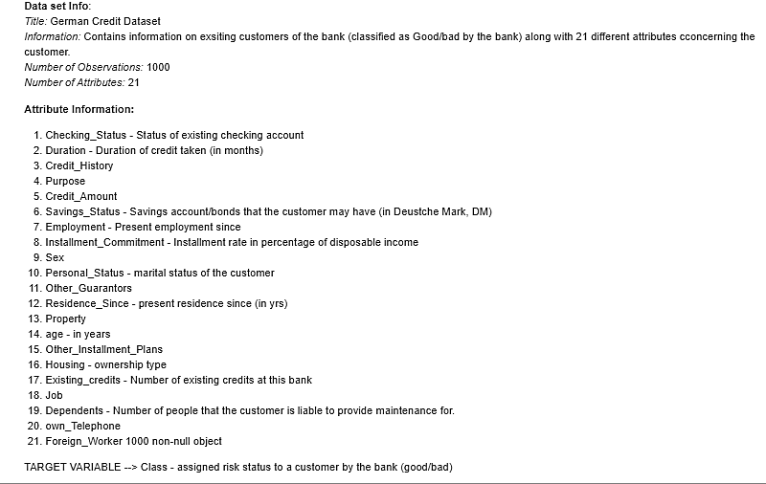
Given Data
The Dataset contains 1000 observations across 22 variables (including the Target Variable - > Class of Client classified as good/bad by the bank).
There are 8 numeric variables and 14 categorical variables. There are no missing values in the dataset.
The data set contains information on variables that may affect an individual’s willingness to take loans and ability to pay back.
We studied each of these variables individually and in combination to understand their relationship with each other and to see any dominant characteristics of good/bad clients
Advanced Analytics: Group 6

Slide 5
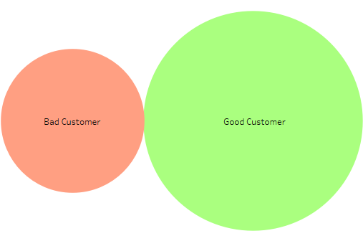
TARGET VARIABLE -> Class (Good/Bad)
Exploratory Data Analysis
Advanced Analytics : Group 6
30%
70%
The given dataset is unbalanced and has only 30% values corresponding to Class=Bad type.
This makes it difficult to model for identification of “bad” loan takers with high accuracy.
In the coming sections we will discuss the steps taken to manage this issue within models.

Slide 6
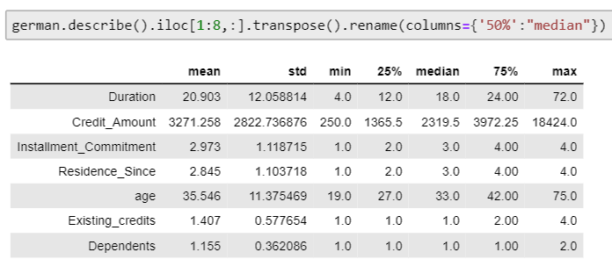
Numerical Variables
Exploratory Data Analysis
Advanced Analytics : Group 6
Almost all the numerical variables are skewed. In other words:
Most loan takers were between 25-30 years of age.
Loans with longer durations (20-21 months on average) are preferred
Most loan takers have atleast one existing credit with the bank ( however, as we will see later, most of the clients do not have an actual account with the this bank)

Slide 7
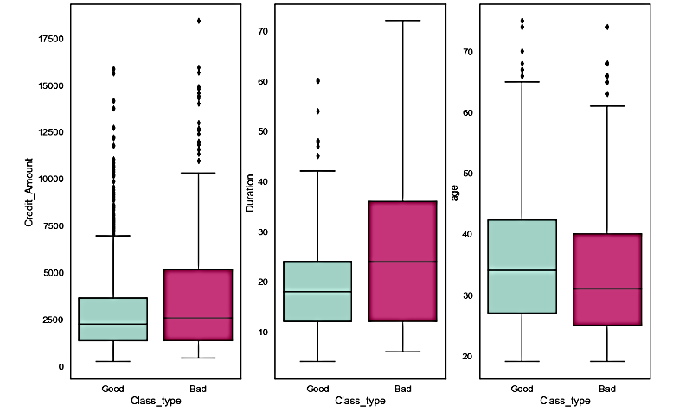
Numerical Variables
Even though they form only 30% of the data set, “Bad” loan takers show some distinct characteristics:
1. They take larger loan amounts (average around 3900 DM as opposed to 2900 DM taken by “good” clients).
2. They take loans for longer duration (average around 29 months as opposed to 19 months taken by “good” clients).
3. They also tend to be younger (though there isn’t a significant difference, since most loan takers are between 25-30 years)
Advanced Analytics : Group 6

Slide 8
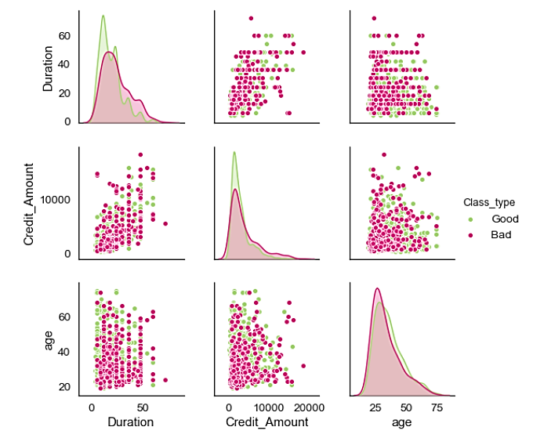
Numerical Variables
In general, the plot re-iterates the following:
1. Most loans taken are of smaller amounts and smaller duration.
2. Most loan takers are young people between the age of 25-30yrs.
3. Older loan takers take larger loans for longer periods – not very reliable candidates
4. As is intuitive, larger loan amounts are taken for longer durations – there is high correlation between the two – either of the two variables may be sufficient in a single model.
Advanced Analytics : Group 6

Slide 9
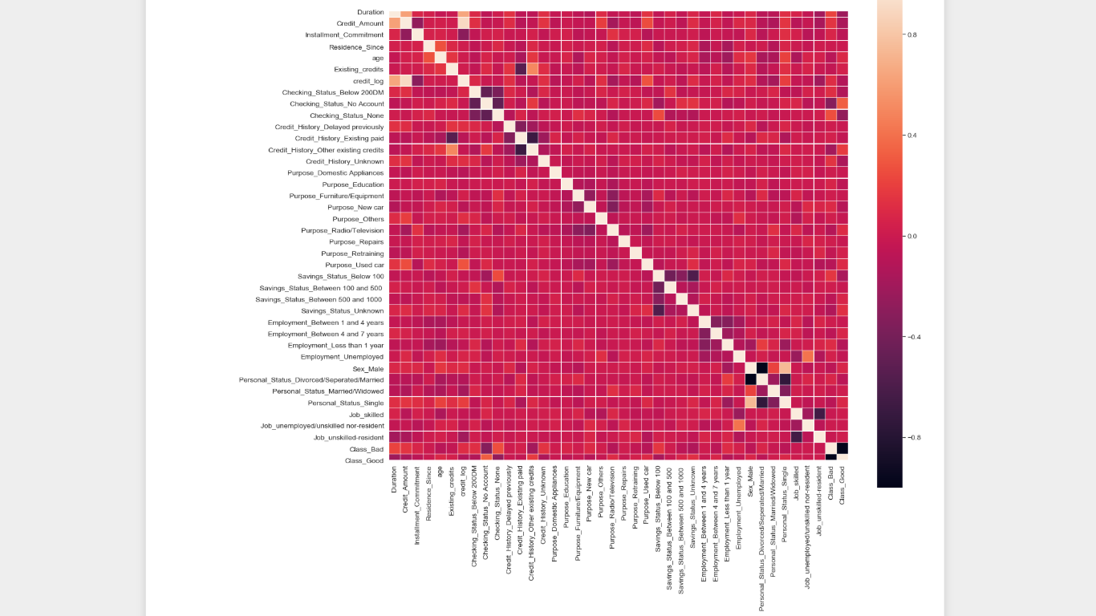
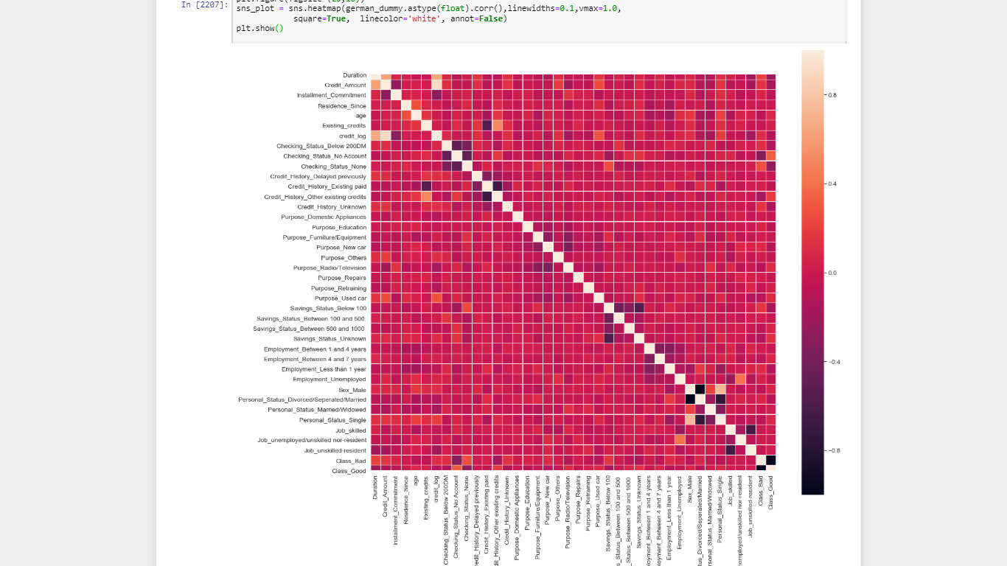
Categorical Variables
The heat-plot is a visual representation of the correlation between all the variables in the dataset.
Near White and near black end of the spectrum indicated a very high degree of correlation (+ve and –ve respectively)
Ignoring the diagonal, most high correlation cases are between dummies created out of the same categorical variables.
Age and length of Residence are weakly correlated.
Duration and Credit amount are strongly correlated.
0.8
0.4
Advanced Analytics : Group 6
- 0.0
- 0.4
- 0.8

Slide 10
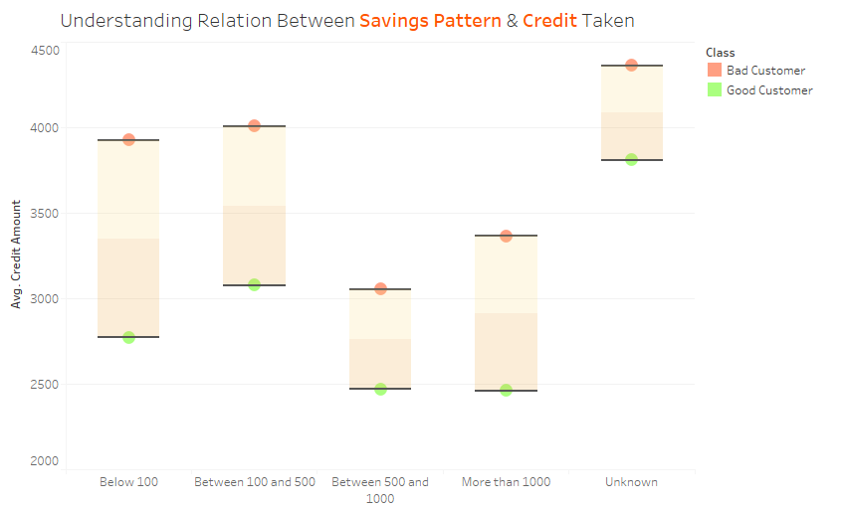
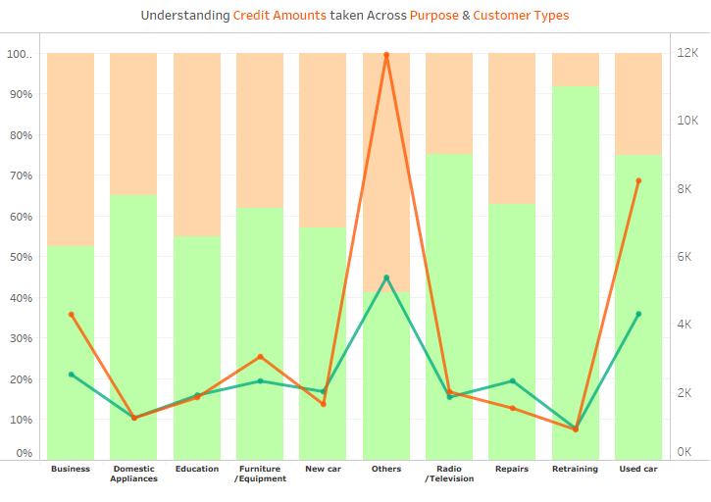
Categorical Variables
Advanced Analytics : Group 6
Most “Good” customers are prudent.
Surprisingly, higher savings do not encourage higher loan seeking
The line represents median credit amount and the bars are percentage of Credit amount.
While most expensive loans were taken for “Other” category, most “good” were given for “retraining”, radio/Tv and cars.

Slide 11
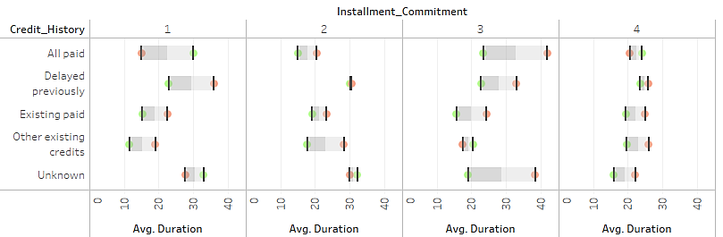
Categorical Variables
Advanced Analytics : Group 6
Customers who have delayed before tend to take loans for longer duration.
We know that most customers opt for installment commitments of around 2 and for around 20-20 months

Slide 12

Broad Profiling of a “Bad” Client
They tend to be younger, opt for larger loans for longer durations. Our data has majority males and singles, therefore, it is hard to make any conclusive statement about the demographic characteristics of a “bad” loan taker.
Lets try to qualify this through our modelling exercise
Advanced Analytics: Group 6

Slide 13
One Hot Encoding
Advanced Analytics: Group 6
All the categorical variables in the data set were one-hot encoded.
Standardization/Scaling
For each of the models we also tested using Standardised (using StandardScaler) and Scaled(MInMax Scaler) data
Data Preprocessing
Stratification
Since the data is imbalaned, we used stratification at the time of splitting data to ensure training and test samples were no more biased than original
Techniques used to transform data before modelling exercise

Slide 14
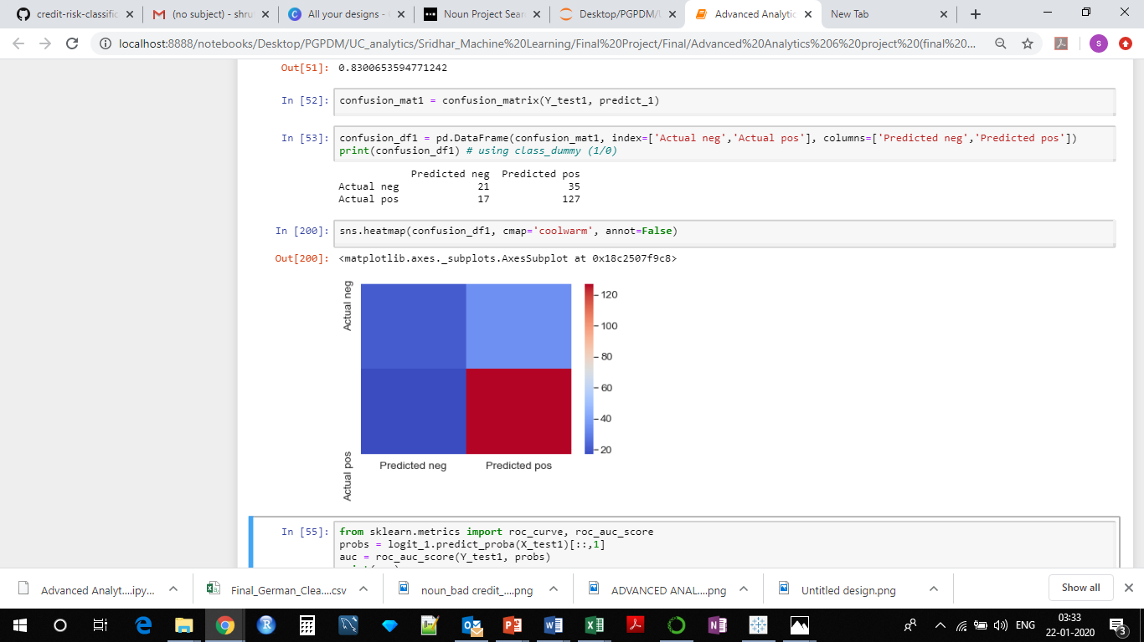
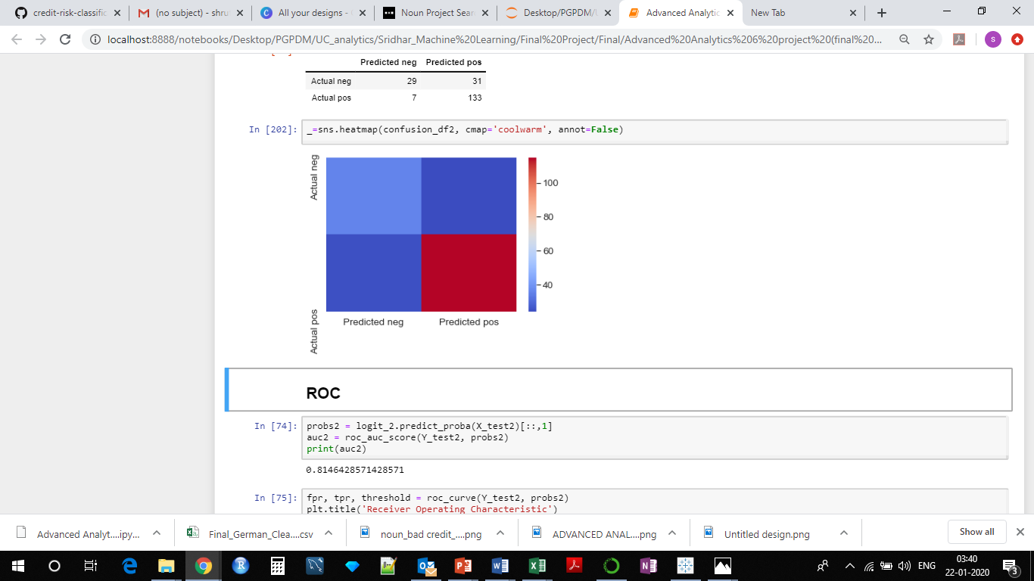
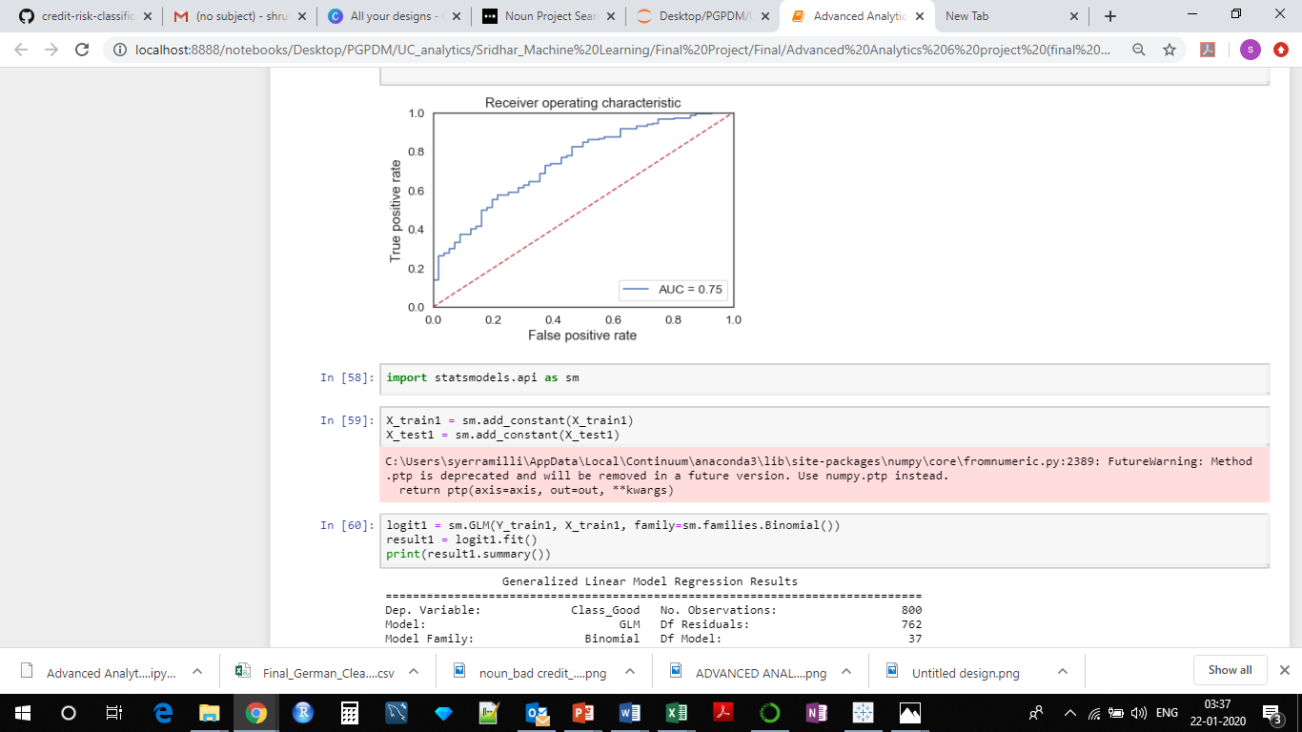
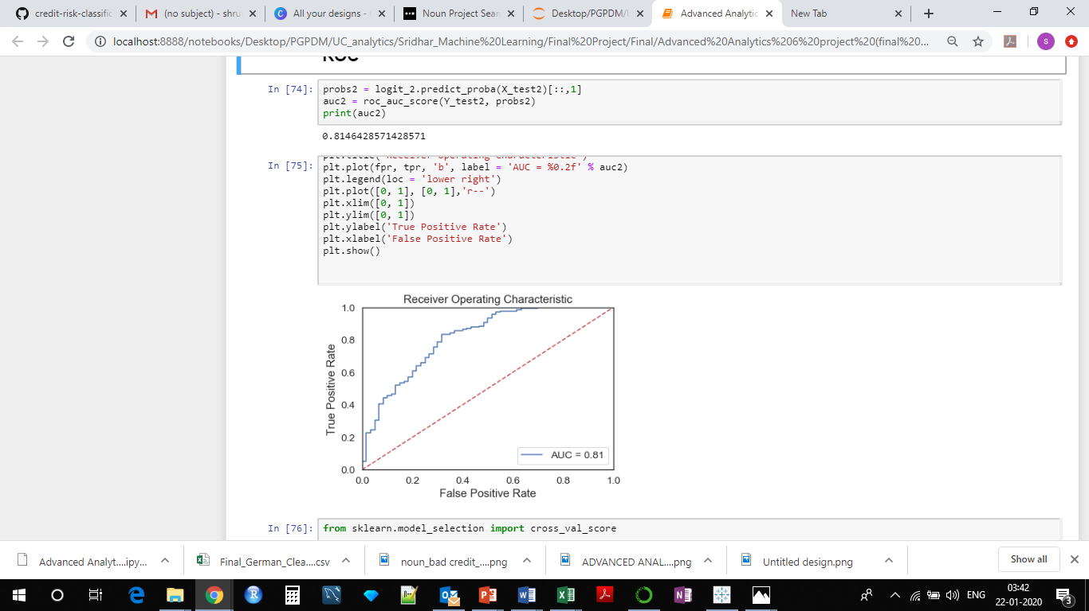
Confusion Matrix & ROC – ordinary Logit
Confusion Matrix & ROC – Logit with Stratification
Advanced Analytics: Group 6
Actual Neg
21
35
29
31
Actual Pos
Choosing Stratification
17
127
7
133
Predicted Neg
Predicted Pos
We used stratification to ensure that train-test splits do not further bias our unbalanced sample.
Above was a simple trial run to check if stratification would improve model performance, given our logic. As we can see the AUC score improves from 0.75 to 0.81. Also the recall and precision of the model have both increased !

Slide 15
Advanced Analytics: Group 6
Rational behind dropping features manually
Dropping Unnecessary Variables
We remove "Other_Guarantors", "own_Telephone", "Foreign_Worker", "Num_of_dependents","Property", "Other_Installment_Plans", "Housing" based on our understanding draw from the EDA exercise.
a. Num_of_dependents - 84.5% values are equal to 1
b. Foreign_Worker - 96.5% values are equal to "Yes"
c. Other_Guarantors - 90% values are eqaul to "None”
d. Other_Installment_Plans - 81% values are equal to "None"
These variables were not considered defining and hence were dropped. Own_telephone was not considered an important determinant of an individual's credit worthiness and was also dropped.
Removing "Other_Guarantors", "own_Telephone", "Foreign_Worker", "Num_of_dependents”, "Other_Installment_Plans", "Housing"

Slide 16
Primary Concerns
We Were mindful of the fact that our dataset is unbalanced and so models like Boosting might work better than Bagging.
The datasets has majority categorical variables. There are too many zeros and possibly near identical columns in the dataset post one-hot encoding. This is also why PCA was not useful in here.
Choosing Appropriate Model
Advanced Analytics: Group 6

Slide 17
Models Tried
We tried 12 classification models for comparison. The models were tried in an effort to see if we could improve our accuracy score of 80% with logistic regression (stratified).
For logistic regression, ensemble- voting and AdaBoost model, we tried all three cases – ordinary datasets(with dummy variables), stratified dataset and standardized dataset.
Universally, stratification gave significantly better accuracy scores for all models.
Choosing Appropriate Model
Advanced Analytics: Group 6

Slide 18
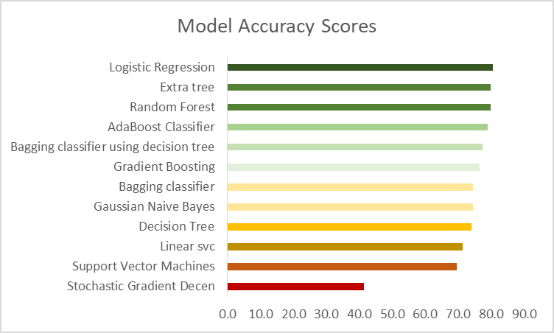
Choosing Appropriate Model
Advanced Analytics: Group 6
Comparing Accuracy Scores across Models (with stratification)
Best Accuracy Achieved – 81%
After trying 12 models for classification, we find that a simple logistic regression and random forest model do equally well (both post stratification of the train-test split)

Slide 19
For Automation of Loan Candidate Selection, we recommend using random forest model – being an ensemble model it may deal better with newer data points being added over time.
Random Forest Classifier
Accuracy_Model6: 0.80
Recall_Model6: 0.95
Precision_Model6: 0.80
Logistic Regression
Accuracy_Model6: 0.81
Recall_Model6: 0.95
Precision_Model6: 0.81
Recommendations
Advanced Analytics: Group 6
The bank may benefit from also from noting that smaller credit amounts disbursed for shorted duration have been profitable for the bank and also see less defaults.

Slide 20
Final Project Submission
Thank You
Advanced Analytics: Group 6

